Slide 1
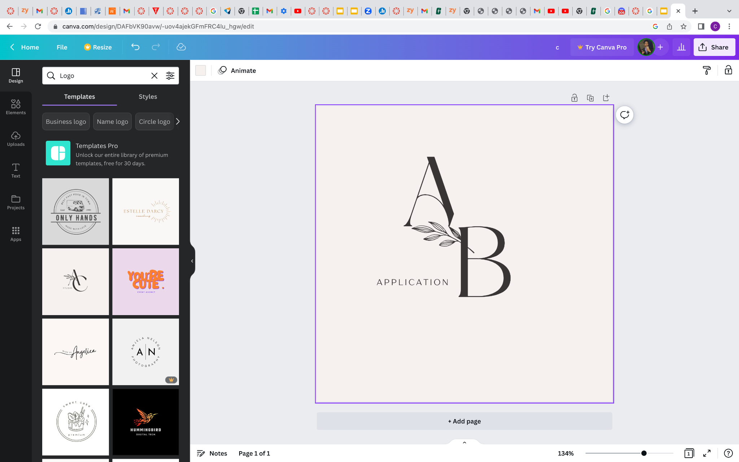
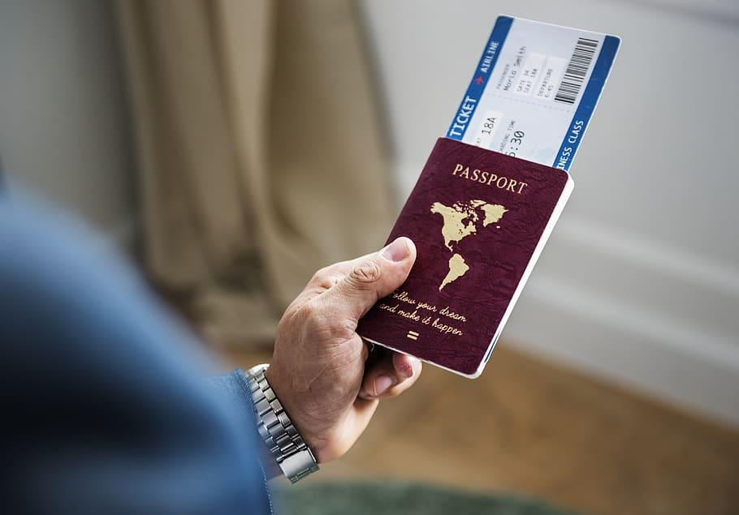

ABA: Airplane Booking Application
Front- End: Chris Davis, Grant Basham, Calvin Wu,
Casey Mock, Peyton Roden, Noah Parkes

Slide 2






Book your Flight!
Sign In
Ticket No. Entry
Click Here!
Click Here!
Click Here!
Customer Support
Click Here!
Try searching for a city, a specific hotel, or even a landmark!
ABA is a airplane search with an extensive price comparison. The prices shown come from numerous airplane booking websites. This means that while users decide on ABA which flight best suits their needs, the booking process itself is completed through the booking sites . By clicking on the “view deal” button, you will be forwarded onto a booking site where you can complete the reservation for the airplane deal found.
Click Here
Click Here!
Click Here!
Click Here!
Click Here!
Click Here!

Slide 3
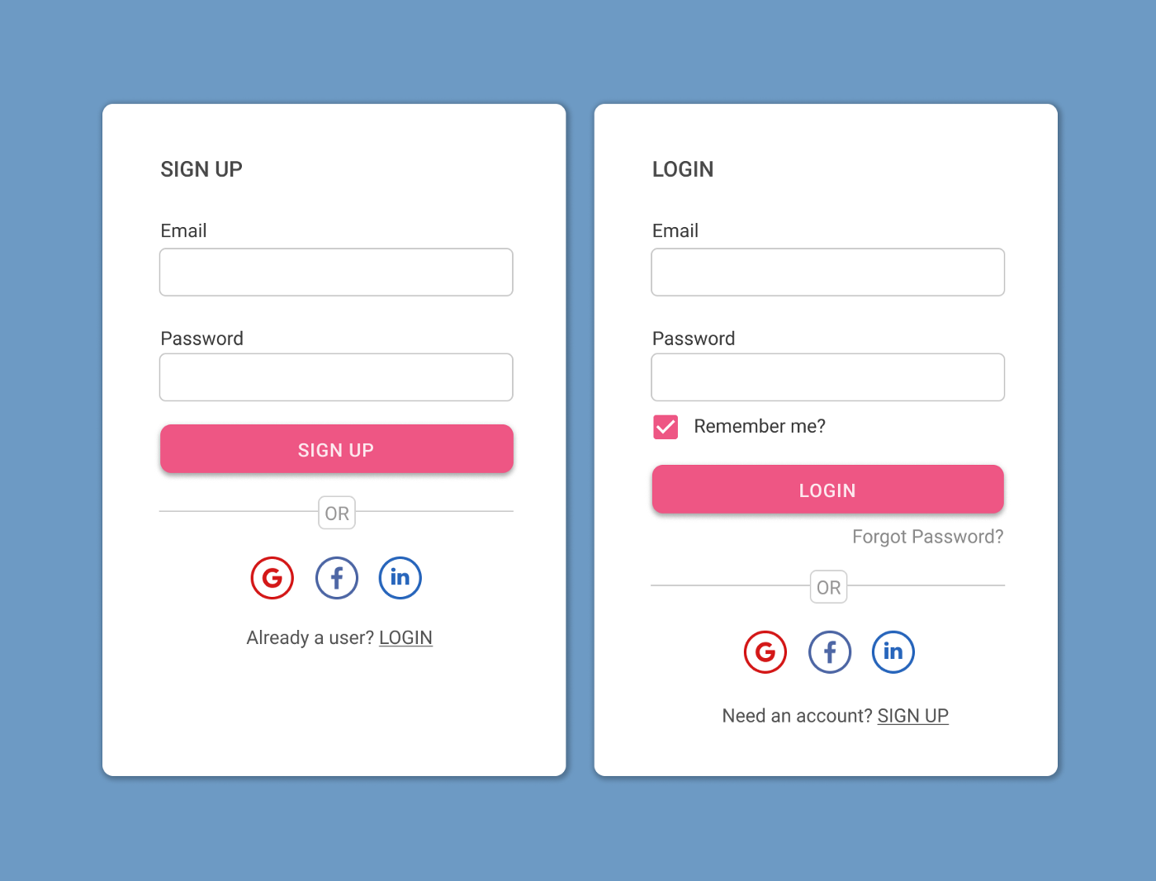
Sign Up
HOME
cdavi261@uncc.edu
cdavi261@uncc.edu
**********************************
**********************************
Sign Up!
Sign Up!
Forgot Password?

Slide 4
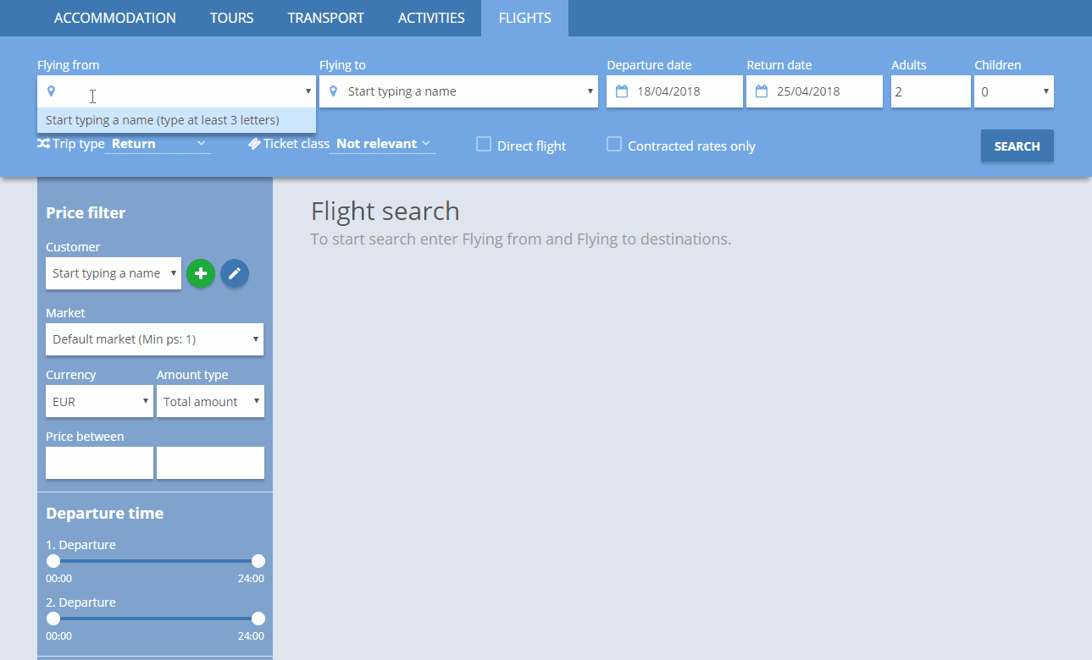
(RDU)Raleigh, Durham
(JFK) New York
06/01/2023
06/15/2023
2
2
Search
Home

Slide 5
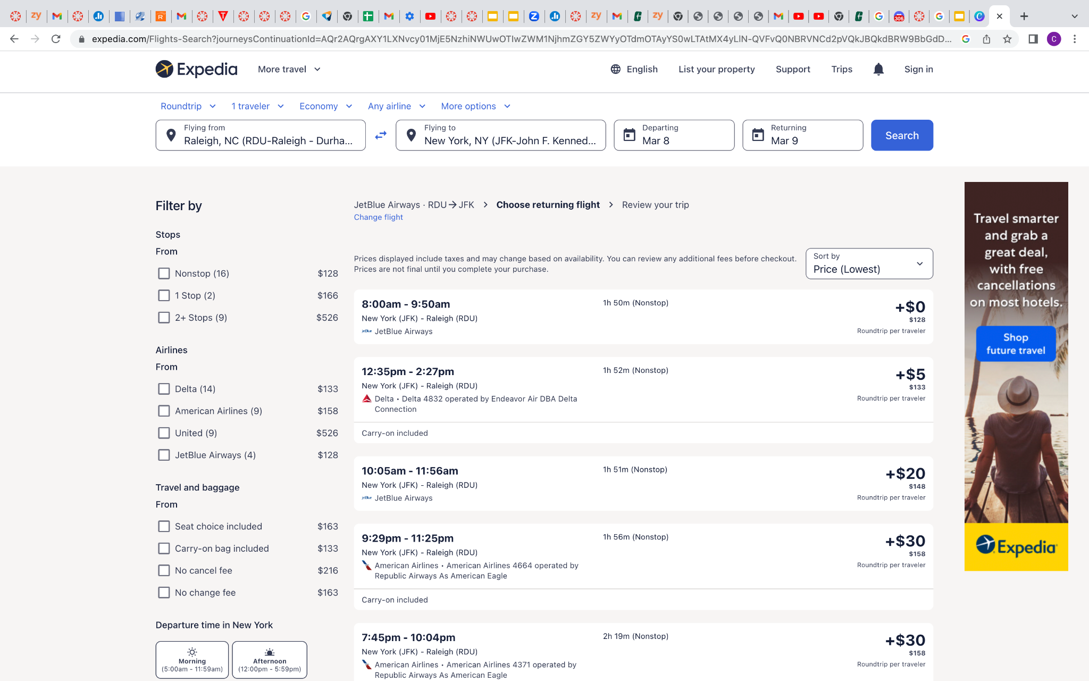
Home
(RDU)Raleigh, Durham
(JFK) New York
06/01/2023
06/15/2023
2
2
Search

Slide 6
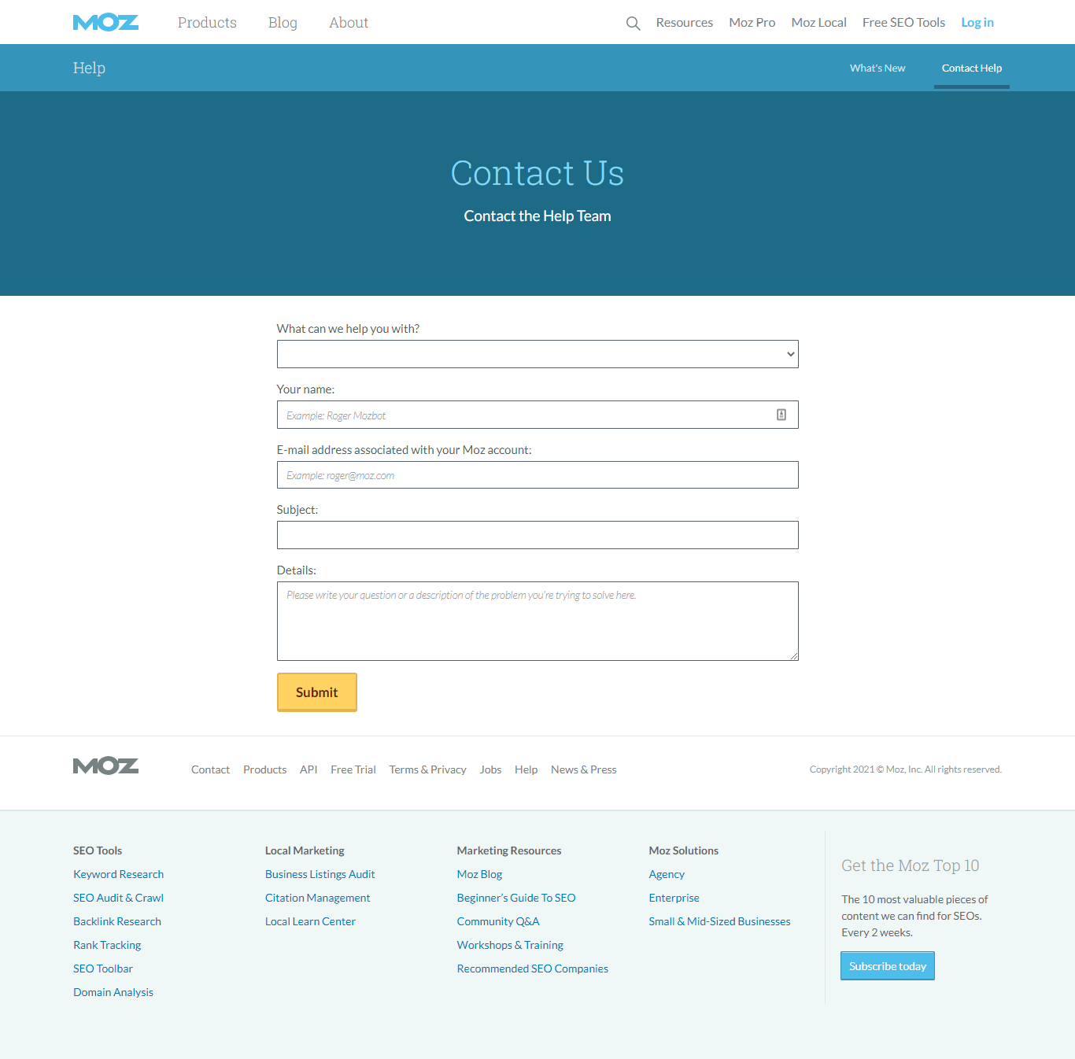
Home
ABA Account

Slide 7
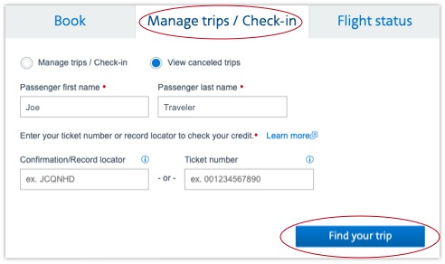
Home

Slide 8
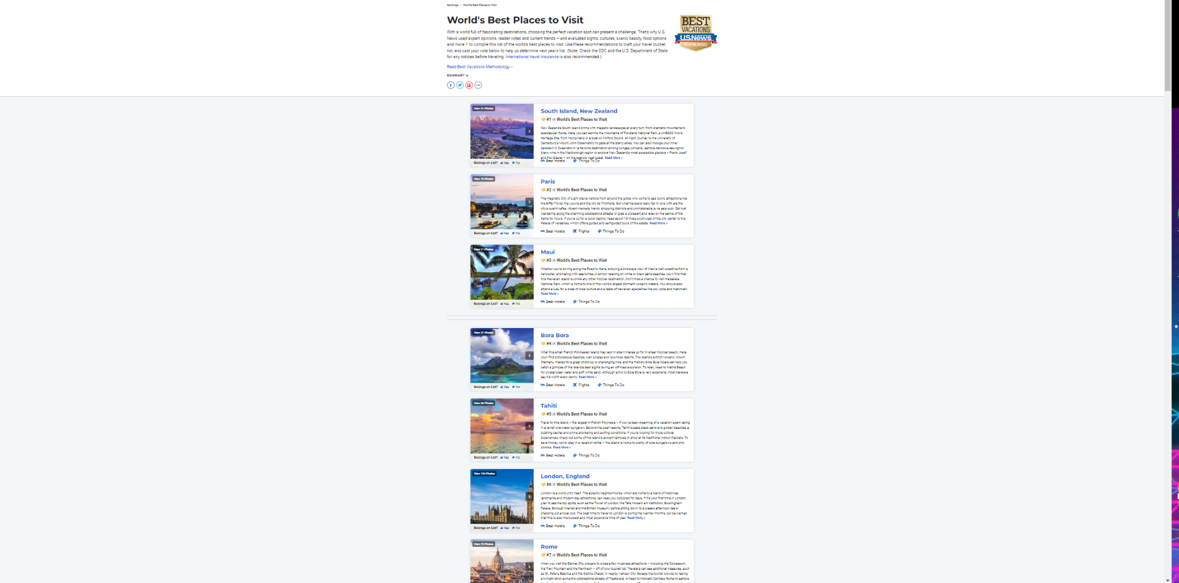
Filter By
Bottom
Home

Slide 9
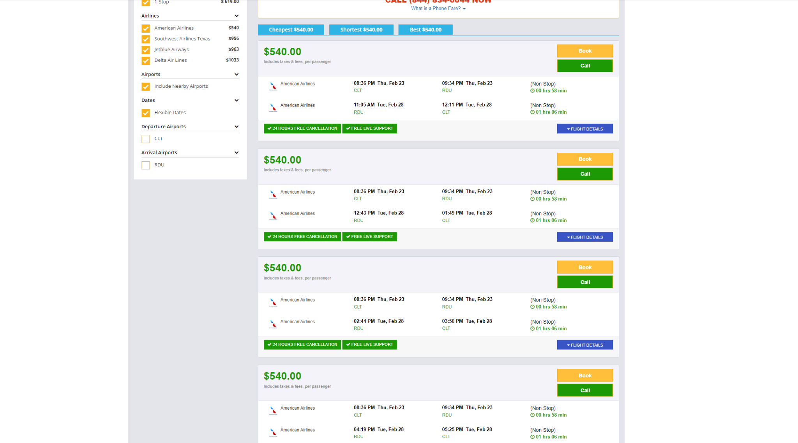
Filter By
Bottom
Home

Slide 10
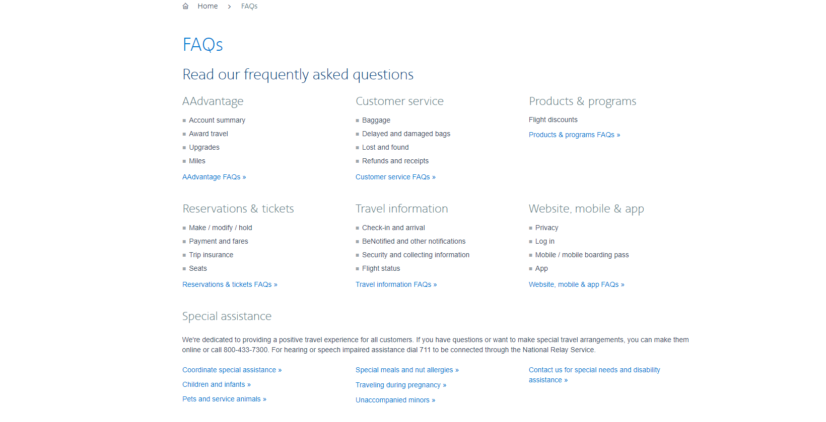
Home

